Slide 1
ITC-6000 Database Management Systems Final Project Presentation 2023 Fall B Payroll Management System Under the guidance of Dr. Farnaz Derakhshan
By
Nithin Reddy Penta Reddy
pentareddy.n@northeastern.edu

Slide 2
Overview
Project Overview
Persona’s
Persona Example
Business Rules
ER Diagram
System Architecture
SQL examples
Metrics & Analytics
Security & Privacy
Take away & Future Considerations
References

Slide 3
Project Overview
Payroll Management System is a pivotal part of any organizations. This helps the organization to function smoothly and allows authorized personal to effectively implement internal changes which take place every financial year. This platform enables employees as well as employers to track the changes on regular basis with restrictions based on “Need To Know Policy”.
Personally, I am looking forward to learn how PMS functions so that I can understand how companies use designation, job description, experience to calculate the salary, tax, bonus of the employees. This knowledge will give me an edge while negotiating my base pay in real time.

Slide 4
USER Personas
There are four primary yet different user personas for the PMS, which also provide a brief description of their responsibility.
HR Admin
They are responsible to manage the entire payroll system and employee records. They should efficiently add and manage records such as Name, ID, DOB, DOJ, Base Pay, Designation, they are expected to initiate payroll process, generate timely report, manage user roles and permissions to ensure data security and company policy
Department Manager
Their role is to monitor and approve timecards, attendance, billing for their department's employees, raise query to HR Admin to adjust employee payroll as needed.
Employee
The Employee are allowed to access their payroll information such as pay slips, Tax Forms, submit billing time/timecards, and request leaves via a login credentials.
Tax Specialist
Tax Specialist is responsible for managing and updating tax categories and rates within the system. They must always ensure accurate and up-to-date tax information.

Slide 5
Persona Examples
HR
HR Admin has full access to all functionalities of the application
Can create and manage user accounts and their access points as well as generate login’s
Ensures compliance with data security, access control and company policies
Department Managers
They can only access and manage data related to their department
They have the authority to approve leaves, timecards, and payroll adjustments
Access is restricted to specific employees under their supervision
Employee
Access is limited to the employee's own data
Can submit timecards and leave requests, but these need manager approval
Can only view their own payroll information
Tax Specialist:
Limited access to tax-related data and settings
Can only modify tax categories and rates
Ensures that tax calculations and withholding are compliant with current rates and regulations.

Slide 6
Business Rules
An employee will have one bank account.
A payroll is generated for each employee in a payroll period.
Every department is managed by one employee/manager.
An employee should submit multiple timecards for different dates.
A user will have one user type.
A position is assigned to one employee in a department.
A payroll should include deductions such as taxes and other deductions.
An employee can request time off for specific dates.

Slide 7
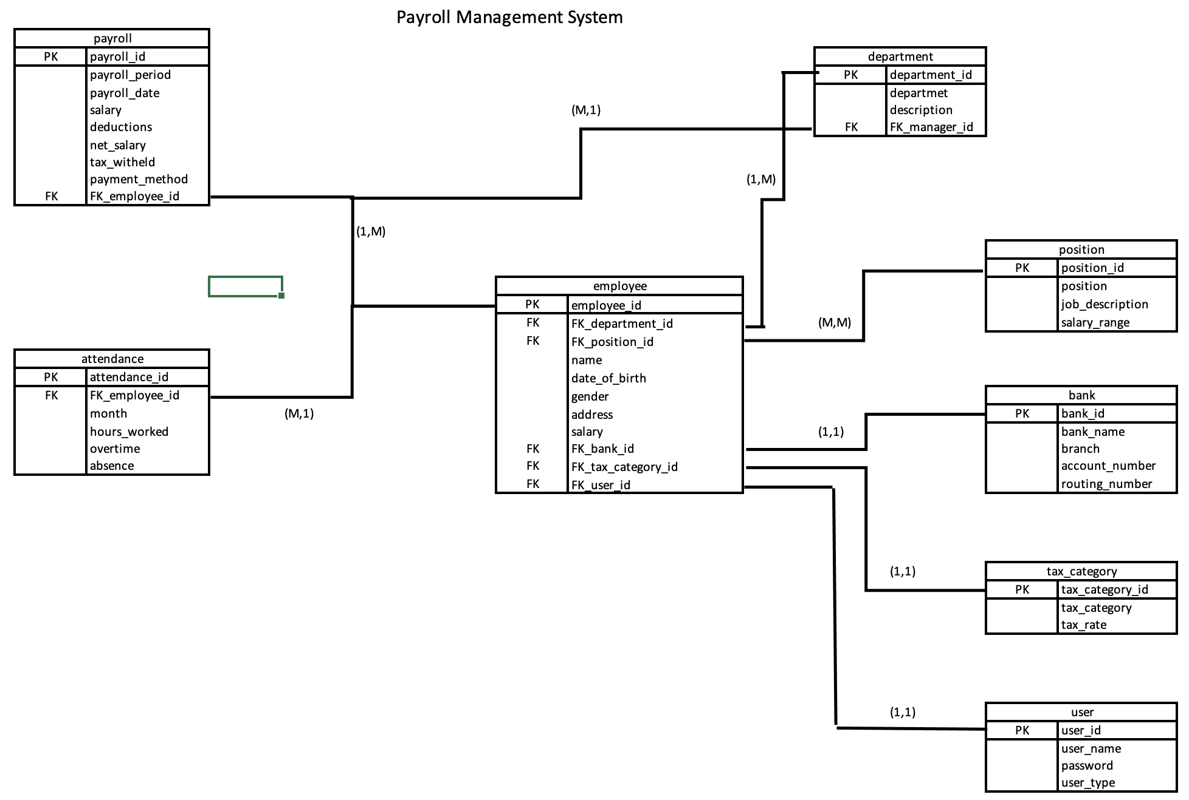
ER Diagram
ER DIAGRAM

Slide 8
Payroll Management System Architecture
Architecture Overview:
Client/Server Structure: The system operates on a client/server model. Users interact with a client (web or desktop app), connecting to a server housing the database and application logic.
Hosting:
Cloud-Based Hosting: Opting for cloud platforms like AWS, Azure, or GCP for scalability, accessibility, and robust data security.
Database:
Relational Database (RDBMS): Using robust systems like PostgreSQL, MySQL, or SQL Server for efficient data storage and management due to their structural integrity.
System Components:
Frontend Client: User-friendly interfaces developed with technologies like React.js, Angular, Vue.js for web; WPF for desktop apps.
Backend Server: Frameworks such as Node.js, Django, or Spring Boot to handle server-side logic, API interactions, and business rules.
Database Layer: Leveraging the selected RDBMS to efficiently manage data entities and their relationships.
Storage Needs:
Estimation: Ranging from gigabytes to terabytes based on data volume, update frequency, and retention policies. A detailed analysis with the client will yield a more accurate estimation.

Slide 9
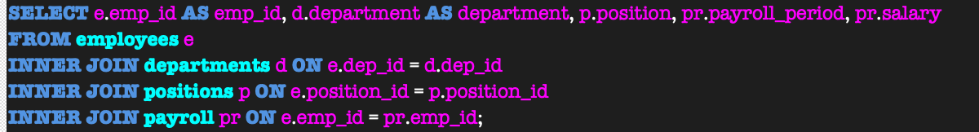
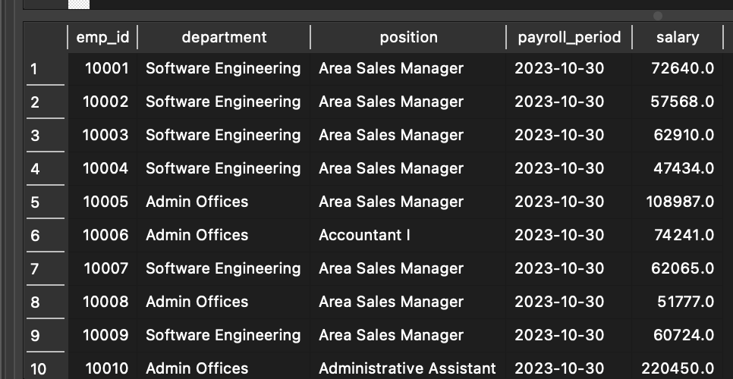
SQL Examples
SQL Statements:
Business Query: HR wants to retrieving employee id, their departments, positions, and payroll details
Explanation:
As month end is approaching, the HR is pulling the payroll information of employee form each department to observe if there are any changes in salary that needs to be credited. The code joins departments, positions and payroll based on dep_id, postion_id and emp.id, bu using JOIN and SELECT function we are able to produce a table where HR can go on with further analysis

Slide 10
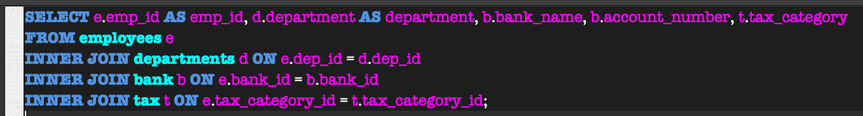
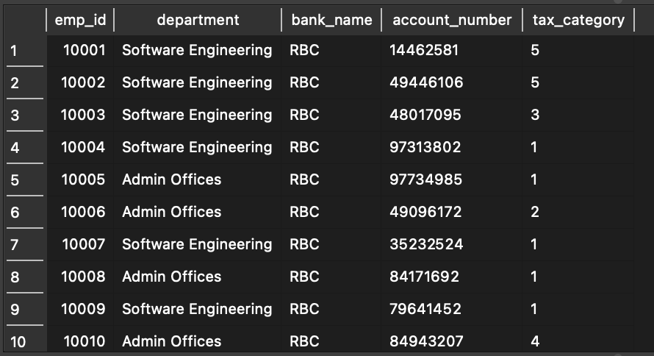
SQL Examples
SQL Statements:
Business Logic: Retrieving employee id, their departments, bank details, and tax categories:
Explanation:
Once the payroll is verified, there HR needs to calculate the tax according to tax category and credit the salary to employee’s account. In-order-to perform these operations, we can use the commands and using SELECT and INNER JOIN functions on departments, bank and tax tabels, we extract the data by mapping them based on dep_id,bank_id and tax_id

Slide 11
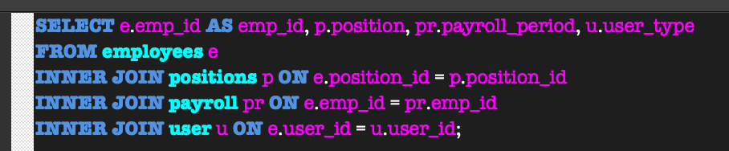
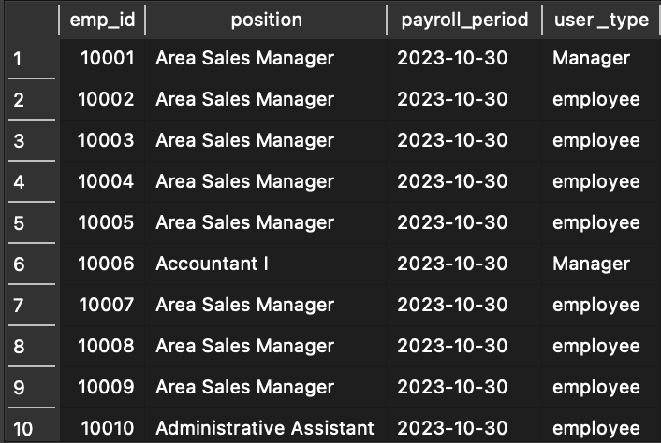
SQL Examples
SQL Statements:
Business Logic: Retrieving employee id, their positions, payroll details, and user account types.
Explanation:
Due to recent changes in Management Structure, the Admis wants to have a look at the user_type as per recent promotion and assign new permission to maintain data integrity and security. By using INNER JION and SELCT function we can select the desired variables to display form the position, employees and users tables based on their dep_id, bank_id and tax category_id.

Slide 12
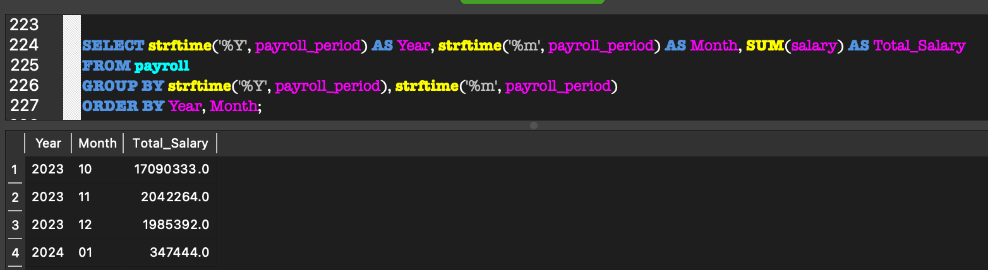
Metrics and Analytics
HR wants to analyse the Total Expenses by the Company as Salary:
The HR manager is looking to pull the salary data of the team to approve, so that the salary can be processed.
From the above table we can see that we have used strtime function to strip the date/year/month associated variables from Payroll table and then groping and ordering them by month and year would produce the required results

Slide 13
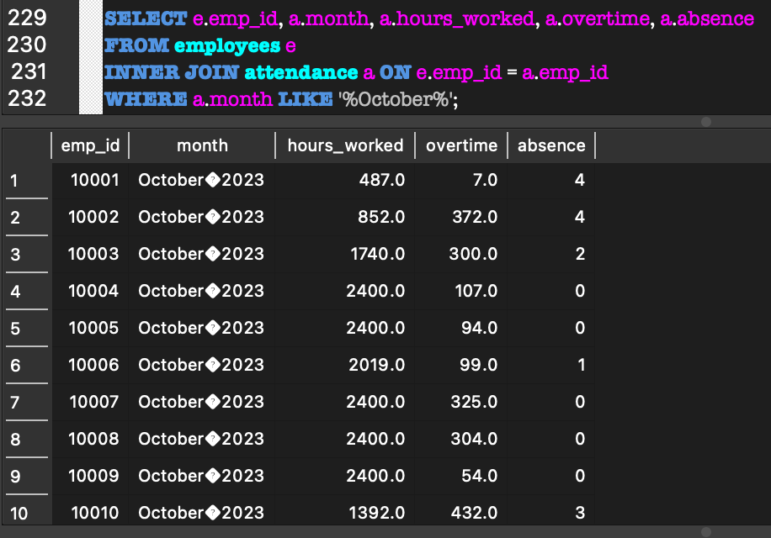
Metrics and Analytics
The the managers to pull the attendance data to approve the attendance
The department manager is looking to pull the attendance data of the team to approve, so that the salary can be processed.
From the above table we can see that we have used JOIN function to map em_id form employees and attendance table and matched the month using LIKE function to display the required data.

Slide 14
Security and Privacy
Data Encryption:
Utilizing SSL/TLS encryption for data transmission between the client and server, ensuring secure communication channels.
Access Control:
Role-Based Access: Implementing role-based permissions (Admin, Manager, Employee) to control access to system functionalities and sensitive data.
Authentication & Authorization: Using secure authentication methods (like multi-factor authentication) and fine-grained authorization to validate user access.
Employee Training:
Security Awareness Programs: Conducting regular training sessions to educate employees about security best practices, reducing the likelihood of human error.
Incident Response Plan:
Emergency Protocols: Establishing a comprehensive incident response plan to swiftly address and mitigate security breaches or data incidents, ensuring minimal impact.

Slide 15
Takeaway & Future Considerations
Take away:
The Project Payroll Management System; has provided insights of managing employee data, business rules, data architecture and generating interactive data using DB SQL lite. Several rules have been laid out to main tata privacy, security and integrity to adhere the regulatory requirements. This project has provided fundamental insights of data management principals, business logic, implementation and data analytics within the realm of payroll management. While this project lacked real world data, this exercise played an critical role in helping me understand about the essence of data driven decision making, ensuring top quality compliance and lastly optimizing the resources.
Future Considerations:
Enhance user experience through in-depth analytics and data visualization.
Implement in house networking feature where employees from different departments can engage
Build a feedback platform to make sure the working environment is not biased, so that the performance can be enhanced

Slide 16
References
KPI: Payroll Management System; [online]: https://www.kpi.com/en/what-is-a-payroll-management-system-and-how-it-helps-your-business/
Asha J (2023, Apr 2023): What is a Payroll Management System and How does it Help Your Business: [online]; https://www.kpi.com/en/what-is-a-payroll-management-system-and-how-it-helps-your-business/
Cleo: On Premise vs. Cloud: Key Differences, Benefits and Risks: [online]; https://www.cleo.com/blog/knowledge-base-on-premise-vs-cloud
Azur: What are public, private, and hybrid clouds?; [online]; https://azure.microsoft.com/en-ca/resources/cloud-computing-dictionary/what-are-private-public-hybrid-clouds
Azur (2023, July, 21): Criteria for choosing a data store: [online]; https://learn.microsoft.com/en-us/azure/architecture/guide/technology-choices/data-store-considerations

Slide 17
Thankyou

